Slide 1
Step 1 – App Structure
Creating the app, the basic structure and the Todo class

Slide 2
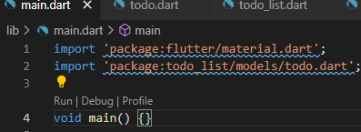
Declutter the Flutter
Start by opening VSCode and creating a new flutter project using the flutter create command.
Call your app todo_list.
Remove the templated counter app code from the main.dart file.
Leave the main() entry point that dart requires, it should look like this:

Slide 3
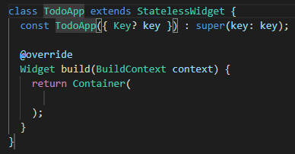
Basic App Structure
For flutter we need to initialise the flutter application by running a built-in command runapp()
To this we pass our main app, which is a widget we create.
The easiest way to do this with VS Code is to type "st" which should open an intellisense window with options.
The second item should be stateless widget, press enter to insert the snippet.
Now enter the name of your app: TodoApp.
Now we can call runApp(const TodoApp()); in main to launch the application.

Slide 4
Material App
Now we can create an application using a helpful widget called Material App.
This sets up some theming and lets us set the main home page.
Replace Container() with Material app and press return.
Remember to use the Ctrl + Space to get a helper of what parameters can be passed to this material app constructor.
Add title & home to the parameters.
Home accepts the page (Still a widget) we are going to display as our homepage.
Enter a string in the title for the app.

Slide 5
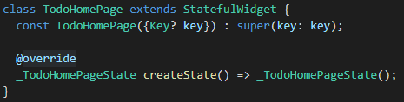
Home Page
Now we need to create our Stateful Widget for the home page.
This is going to be managing its own internal state through the built-in setstate() function.
Like we did before create a new stateful widget this time called TodoHomePage.
Stateful widgets are split up into two parts, the widget and the state.

Slide 6
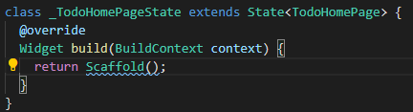
Home Page
The state controls the build method and any dynamic properties that might define or influence its state.
As the app is rebuilt it calls the state to determine what to display.
Now go back to our MaterialApp widget and add the TodoHomePage into its home parameter. (You may need to apply const appropriately here)

Slide 7
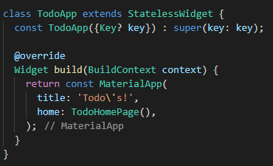
Adding to Material App

Slide 8
Final Setup
Now you should have the following elements:
Main with runApp() function passing in our stateless TodoApp widget.
TodoApp that builds a material app that takes a title and a homepage of a stateful TodoHomePage widget.
Inside that then we finally have our build method that will display the widgets we want to build on our page.
Replace the build methods container with a scaffold with an app bar that has a title of a Text Widget.
Test that we have implemented this correctly by running the app and seeing if it launches correctly.

Slide 9
Todo Class
To the project inside the lib folder create a new folder called models.
This is going to hold our todo class.
Create a new class by creating a new file don’t forget to name it appropriately, including the .dart extension.
Open the file and create a class inside called Todo.
Create a constructor and three properties for name, description and complete.
Finally, we are going to override an inbuilt toString method.
Type String and press space and the override will pop up, press enter.
This will add the @override annotation for us.
Remove the default code and return a string that is the name and the description in a single string.

Slide 10
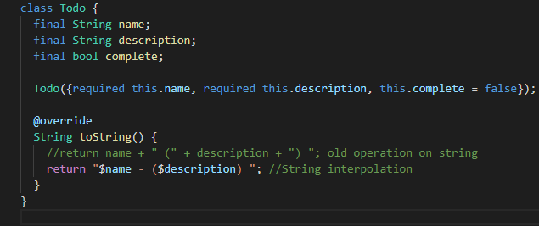
Todo Class – Example

